Slide 1

Genetic/Evolutionary Algorithms

Slide 2
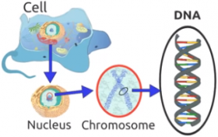
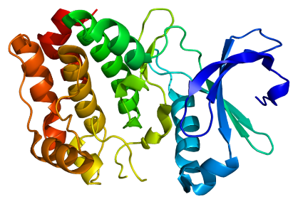
Biological background
All living organisms consist of a set of cells
In every cell of an organism there is the same set of chromosomes.
Chromosomes are strings of DNA with a code containing instructions for building and keeping alive cells (and as a result the whole organism)
These instructions are known as genes, blocks of DNA
Genes encode proteins.
Central dogma of molecular biology: DNA→RNA→Protein
Proteins are the machinery of the cell for a multitude of functions (metabolism, communications, division, etc.)
Roughly, it can be said, that each gene encodes a simple trait, for example eye color.
Combinations of many genes encode complex traits (intelligence, personality, etc)
Possible settings for a trait (e.g. blue, brown) are called alleles.
The complete set of genetic material (all chromosomes) is called a genome.

Slide 3
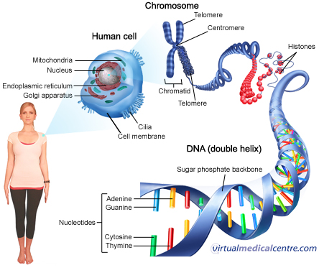
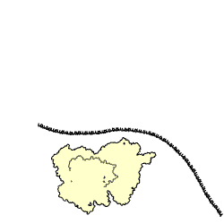
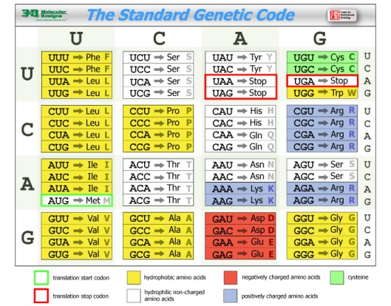
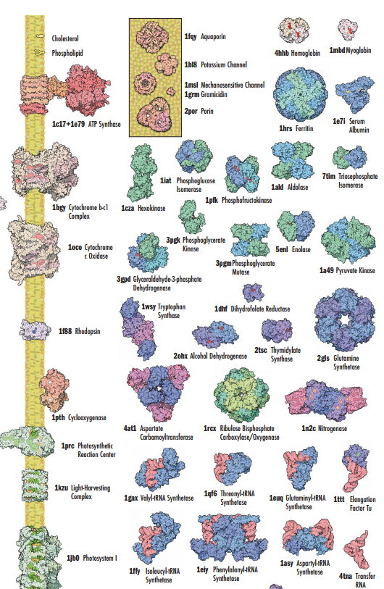
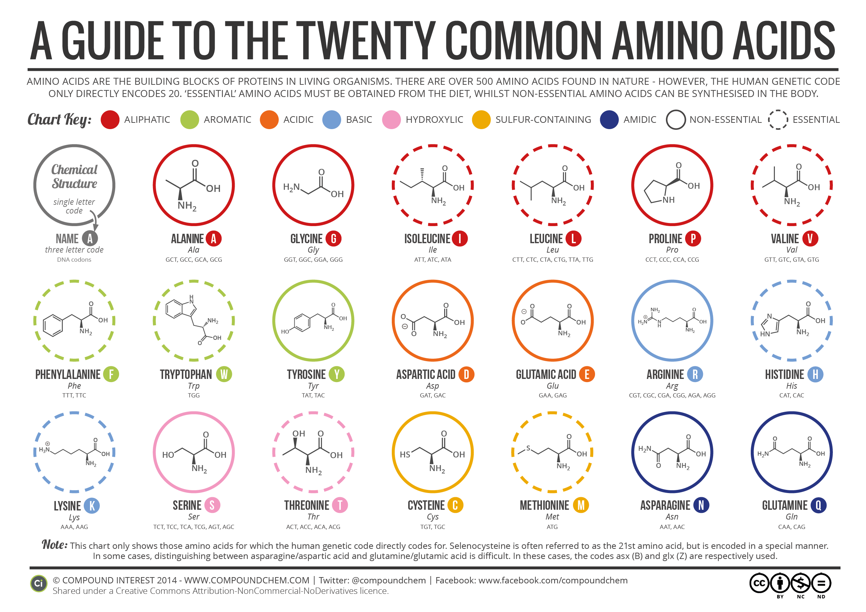
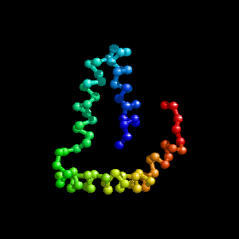
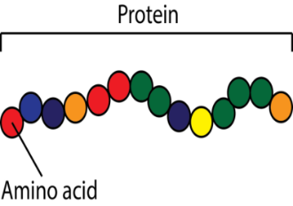
The central dogma of molecular biology: DNA→RNA→Protein
Notes:
DNA seen through the eyes of a coder: https://ds9a.nl/amazing-dna/

Slide 4
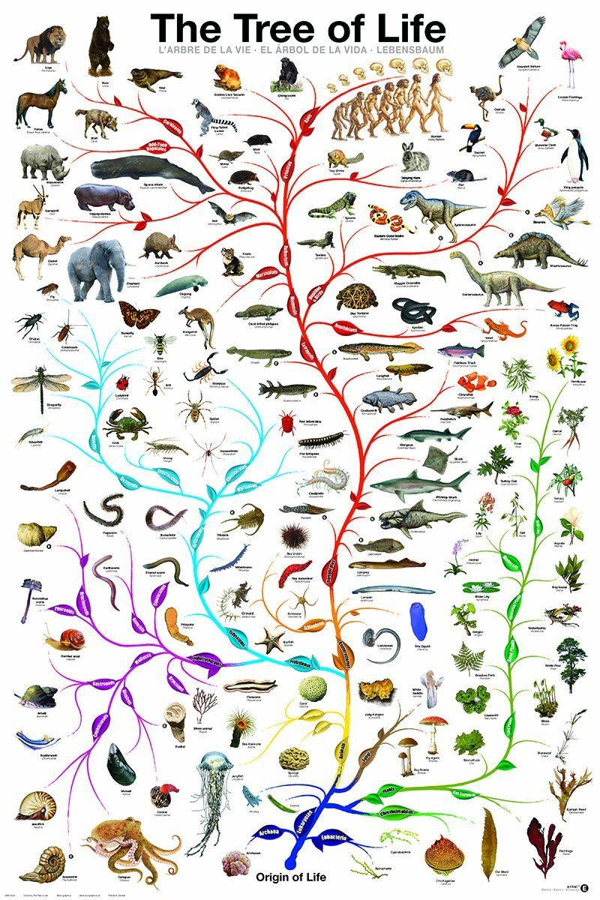
Theory of evolution
The theory of evolution by natural selection, first formulated in Darwin's book "On the Origin of Species" in 1859, is the process by which organisms change over time as a result of changes in heritable physical or behavioral traits.
Changes that allow an organism to better adapt to its environment will help it survive and have more offspring.
Evolution by natural selection is substantiated by evidence from paleontology, geology, genetics and developmental biology.
Albeit, some explanatory gaps and inconsistencies remain
The theory is sometimes described as "survival of the fittest," but that can be misleading
fitness" refers not to an organism's strength or athletic ability, but rather the ability to survive and reproduce
Modern technology has probably disrupted to a certain extent evolutionary forces shaping humans

Slide 5
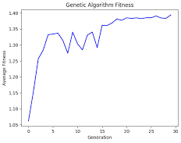
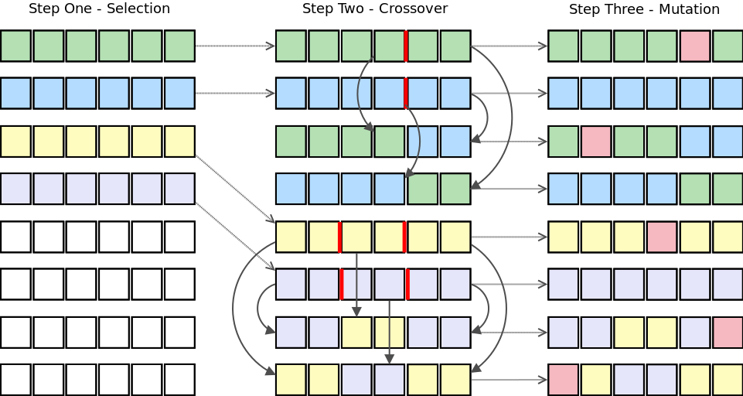
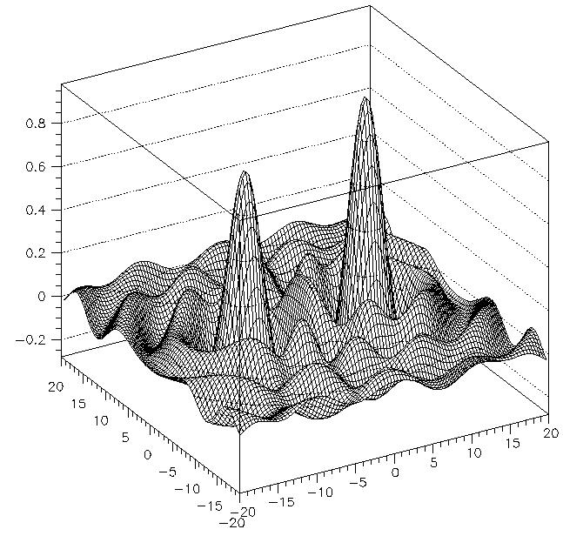
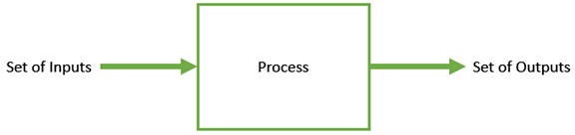
Introduction to GAs
Nature has always been a great source of inspiration to mankind.
Genetic Algorithm (GA) is a search-based optimization technique based on the principles of Genetics and evolutionary natural selection
It is frequently used to find optimal or near-optimal solutions to optimization problems
Optimization is the process of making something better.
The definition of “better” varies from problem to problem, but in mathematical terms, it refers to maximizing or minimizing one or more objective functions, by varying the input parameters.
(Encoding of a solution)
(with associated fitness values)
Notes:
The set of all possible solutions or values which the inputs can take make up the search space. In this search space, lies a point or a set of points which gives the optimal solution. The aim of optimization is to find that point or set of points in the search space.
Doesn’t this sound similar to what machine learning algorithms do?
Yes, but some problems have search spaces that are so vast that current machine learning algorithms are hopeless at them, hence alternative approaches such as GAs are useful

Slide 6
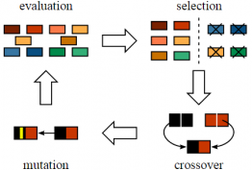
What are genetic algorithms?
In GAs, we have a pool or a population of possible solutions to the given problem. These solutions then undergo recombination and mutation (like in natural genetics), producing new “children”
Each individual (or candidate solution) is assigned a fitness value (based on its objective function value) and the fitter individuals are given a higher chance to mate and yield more “fitter” individuals.
This is in line with the Darwinian Theory of “Survival of the Fittest”.
The process is repeated over various generations

Slide 7
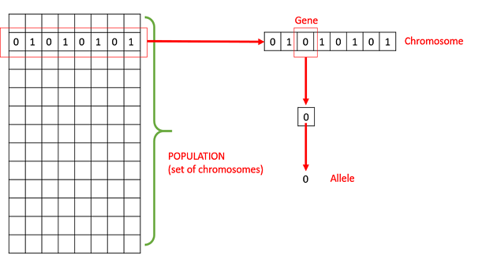
Basic terminology of Genetic Algorithms
Population − A subset of all the possible (encoded) solutions to the given problem. The population for a GA is analogous to the population for human beings except that instead of human beings, we have Candidate Solutions representing human beings.
Chromosomes − A solution to the given problem.
Gene − One element position of a chromosome.
Allele − The value a gene takes for a particular chromosome.

Slide 8
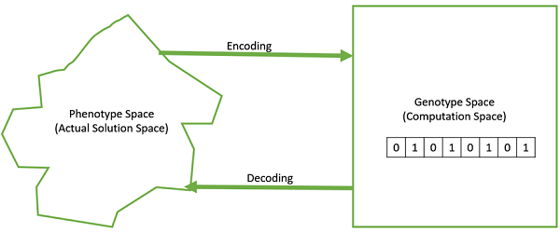
Basic terminology
Fitness
Fitness Function − A fitness function simply defined is a function which takes the solution as input and produces the suitability of the solution as the output.
Plays the role of nature
Genetic Operators − These alter the genetic composition of the offspring. These include crossover, mutation, selection, etc.
Decoding and Encoding − Decoding is a process of transforming a solution from the genotype to the phenotype space, while encoding is a process of transforming from the phenotype to genotype space. Decoding should be fast as it is carried out repeatedly in a GA during the fitness value calculation.

Slide 9
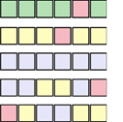
Basic architecture of GAs
Initial Population Generation
7
1
3
0
4
5
6
5
Selection
Crossover
Next Generation
Mutation
Fitness

Slide 10
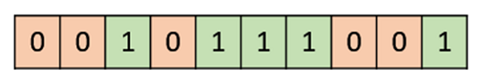
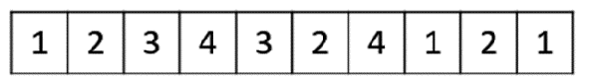
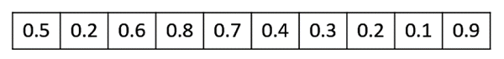
Genotype representation
Deciding how to represent our chromosomes (i.e. candidate solutions or operazionalizations of our problem).
Binary representation: genotype consists of bit strings.
Integer representation: genotype consists of integer values
Real value representation: Genotype consists of continuous rather than discrete variables

Slide 11
Initial Generation of a population
There are two primary methods to initialize a population in a GA.
Random Initialization − Populate the initial population with completely random solutions.
Heuristic initialization − Populate the initial population using a known heuristic for the problem.
Once we have a population we need to choose the population replacement model over iterations/generations of the algorithm
Steady State: we generate one or two off-springs in each iteration and they replace one or two individuals from the population. A steady state GA is also known as Incremental GA.
Generational: we generate ‘n’ off-springs, where n is the population size, and the entire population is replaced by the new one at the end of the iteration.
1 1 0 1 1 0 1 0
0 1 1 1 1 0 1 1
1 1 1 0 1 0 1 0
0 0 0 1 1 0 1 0
0 0 1 1 0 0 0 1
1 1 0 1 1 0 0 0
1 0 1 0 1 0 1 1
1 1 1 0 0 0 1 0
1 0 1 0 0 0 1 0
0 1 1 1 1 0 1 1
Notes:
The diversity of the population should be maintained otherwise it might lead to premature convergence.
The population size should not be kept very large as it can cause a GA to slow down, while a smaller population might not be enough for a good mating pool. Therefore, an optimal population size needs to be decided by trial and error.

Slide 12
Fitness function
The fitness function simply defined is a function which takes a candidate solution to the problem as input and produces as output how “fit” our how “good” the solution is with respect to the problem in consideration.
Calculation of fitness value is done repeatedly in a GA and therefore it should be computationally fast.
A slow computation of the fitness value can adversely affect a GA and make it exceptionally slow.
This should bring a bell about the importance of vectorising if possible the computation

Slide 13
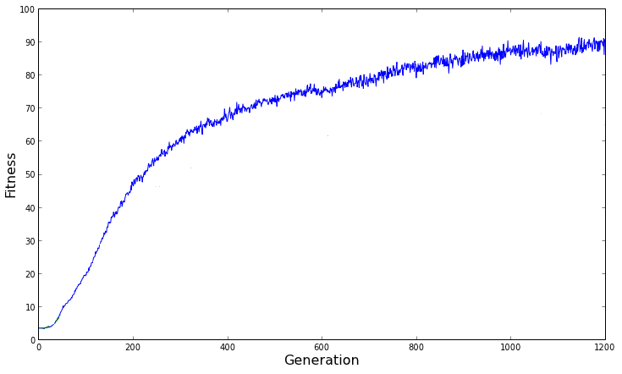
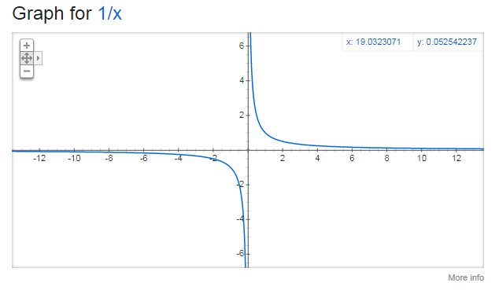
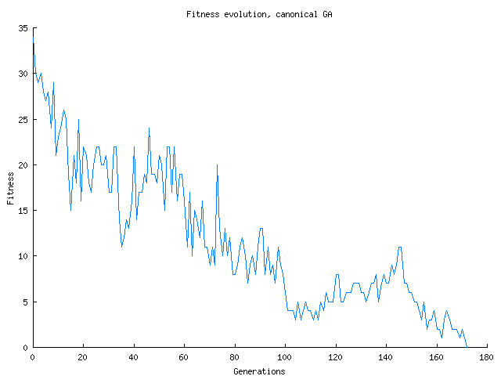
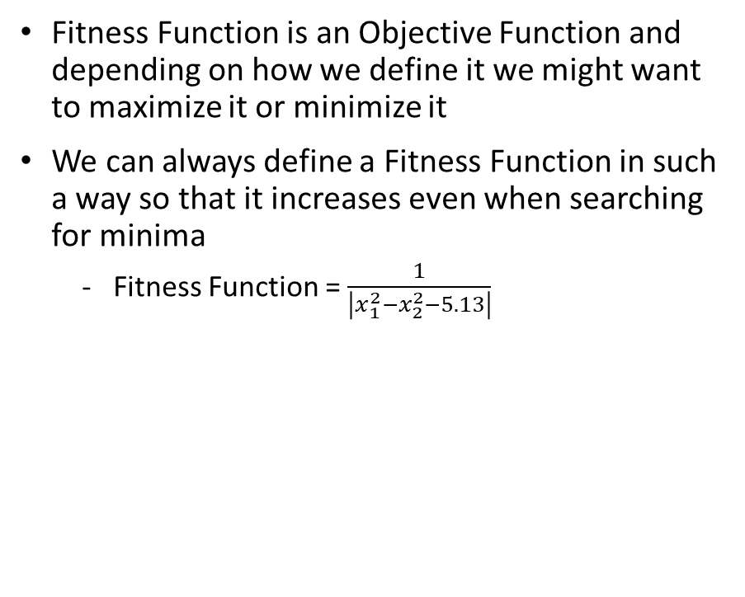
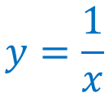
Do we always need to maximize the Fitness Function?
Fitness Function is an Objective Function and depending on how we define it we might want to maximize it or minimize it
We can always define a Fitness Function in such a way so that it increases even when searching for minima
Fitness Function = $\frac{1}{\left|x_{1}^{2}−x_{2}^{2}−5.13\right|}$
$$y=\frac{1}{x}$$

Slide 14
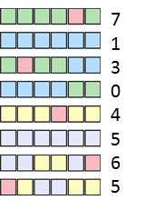
Parent selection
Parent Selection is the process of selecting parents which mate and recombine to create off-springs for the next generation.
Parent selection is very crucial to the convergence rate of the GA as good parents drive individuals to better (i.e. fitter solutions)
However, care should be taken to prevent one extremely fit solution from taking over the entire population in a few generations, as this leads to the solutions being close to one another in the solution space thereby leading to a loss of diversity (crowding).
This taking up of the entire population by one extremely fit solution is known as premature convergence and is an undesirable condition in a GA.
Crowding happens when a highly fit chromosome gets to reproduce a lot, and in a few generations, the entire population is filled with similar solutions having similar fitness.
This reduces diversity which is a very crucial element to ensure the success of a GA.
Thus, maintaining good population diversity is extremely crucial for the success of a GA.
On the other hand, too much diversity also precludes convergence
Too little diversity is bad but so is too much diversity

Slide 15
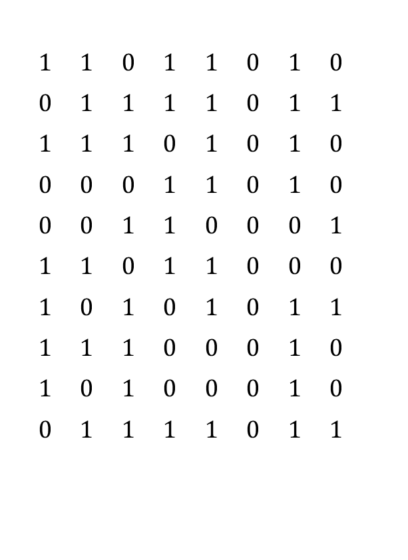
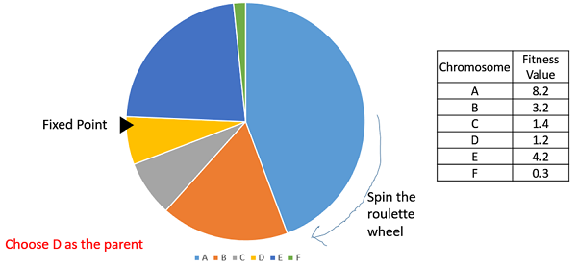
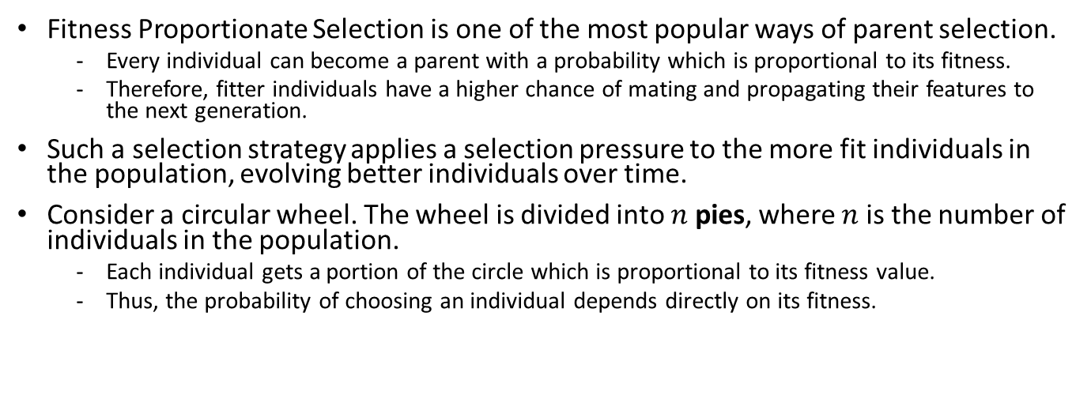
Fitness Proportionate Selection
Fitness Proportionate Selection is one of the most popular ways of parent selection.
Every individual can become a parent with a probability which is proportional to its fitness.
Therefore, fitter individuals have a higher chance of mating and propagating their features to the next generation.
Such a selection strategy applies a selection pressure to the more fit individuals in the population, evolving better individuals over time.
Consider a circular wheel. The wheel is divided into $n$ pies, where $n$ is the number of individuals in the population.
Each individual gets a portion of the circle which is proportional to its fitness value.
Thus, the probability of choosing an individual depends directly on its fitness.
Population sorted by fitness
Select
OR
Discard

Slide 16
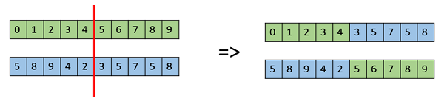
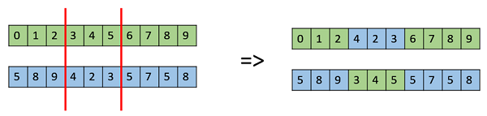
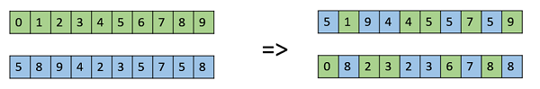
Crossover operation
The crossover operator is analogous to reproduction and biological crossover.
Two parents are selected and one or more off-springs are produced using the crossed over genetic material of the parents.
One Point Crossover
Multi Point Crossover
Uniform crossover

Slide 17
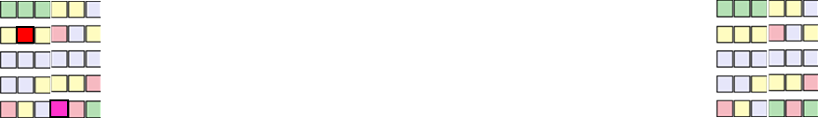
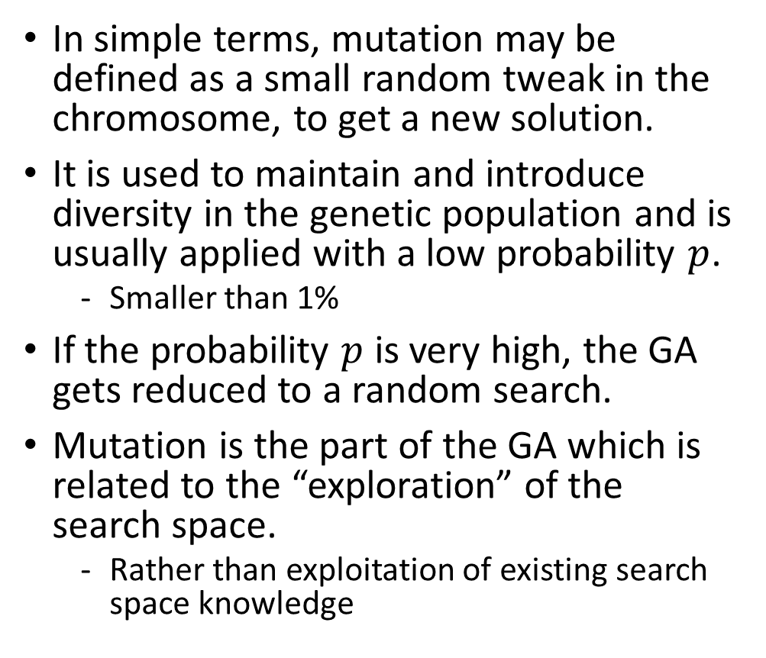
Mutations
In simple terms, mutation may be defined as a small random tweak in the chromosome, to get a new solution.
It is used to maintain and introduce diversity in the genetic population and is usually applied with a low probability $p$.
Smaller than 1%
If the probability $p$ is very high, the GA gets reduced to a random search.
Mutation is the part of the GA which is related to the “exploration” of the search space.
Rather than exploitation of existing search space knowledge

Slide 18
Mutation Operators
Bit Flip Mutation: we select one or more random bits and flip them.
This is used for binary encoded GAs.
Random Resetting: an extension of the bit flip for the integer representation. A random value from the set of permissible values is assigned to a randomly chosen gene.
Swap Mutation: we select two positions on the chromosome at random, and interchange the values.
This is common in permutation based encodings.
Scramble mutation: a subset of genes is chosen and their values are scrambled or shuffled randomly.
Inversion Mutation: we merely invert the entire string in a subset of genes.

Slide 19
Survivor Selection
The Survivor Selection Policy determines which individuals are to be kicked out and which are to be kept in the next generation.
It is crucial as it should ensure that the fitter individuals are not kicked out of the population, while at the same time diversity should be maintained in the population.
In Age-Based Selection, we don’t have a notion of a fitness. It is based on the premise that each individual is allowed in the population for a finite generation where it is allowed to reproduce, after that, it is kicked out of the population no matter how good its fitness is.
In this fitness based selection, the children tend to replace the least fit individuals in the population. The selection of the least fit individuals may be done using a variation of selection policies
tournament selection
fitness proportionate selection
Fitness threshold
etc.

Slide 20
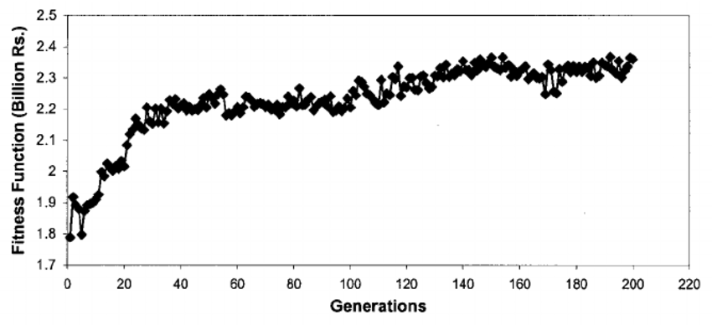
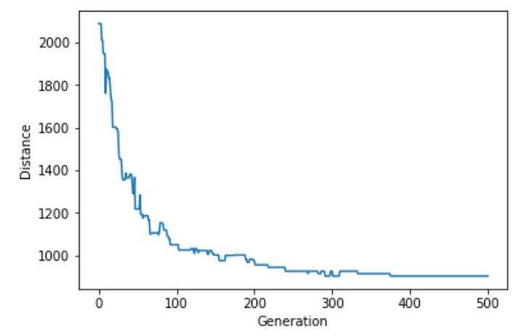
Termination Condition
The termination condition of a Genetic Algorithm is important in determining when a GA run will end.
It has been observed that initially, the GA progresses very fast with better solutions coming in every few iterations, but this tends to saturate in the later stages where the improvements are very small.
i.e. asymptotic growth/decrease
We usually want a termination condition such that our solution is close to the optimal, at the end of the run.
We can use one of the following termination conditions −
When we reach an absolute number of generations.
When there has been no improvement in the population for X iterations.
When the objective function value has reached a certain pre-defined value.

Slide 21
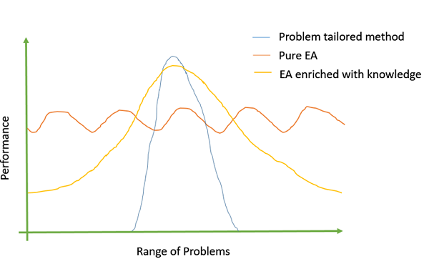
Introduce problem-specific domain knowledge
In genetic algorithms, there is no “one size fits all” or a magic formula which works for all problems. Even after the initial GA is ready, it takes a lot of time and effort to play around with the parameters like population size, mutation and crossover probability etc. to find the ones which suit the particular problem.
It has been observed that the more problem-specific domain knowledge we incorporate into the GA; the better objective values we get.
Adding problem specific information can be done by either using problem specific crossover or mutation operators, custom representations, etc.

Slide 22
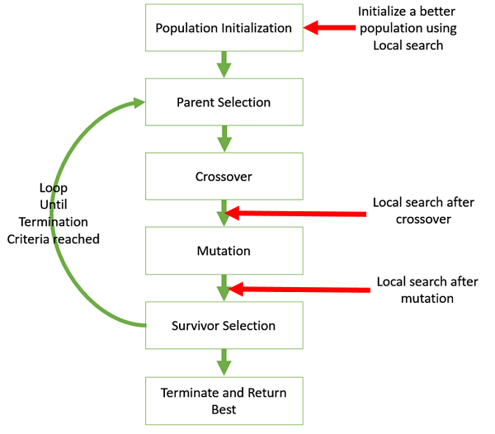
Exploration versus exploitation trade-off
Hybridize GA with Local Search
Local search refers to checking the solutions in the neighborhood of a given solution to look for better objective values.
It may be sometimes useful to hybridize the GA with local search.

Slide 23
Application Areas
Optimization − Genetic Algorithms are most commonly used in optimization problems wherein we have to maximize or minimize a given objective function value under a given set of constraints.
Economics − GAs are also used to characterize various economic models like the cobweb model, game theory equilibrium resolution, asset pricing, etc.
Neural Networks − GAs are also used to train neural networks, particularly recurrent neural networks.
Parallelization − GAs also have very good parallel capabilities, and prove to be very effective means in solving certain problems, and also provide a good area for research.
Image Processing − GAs are used for various digital image processing (DIP) tasks as well like dense pixel matching.
Vehicle routing problems − With multiple soft time windows, multiple depots and a heterogeneous fleet.
Scheduling applications − GAs are used to solve various scheduling problems as well, particularly the time tabling problem.
Machine Learning − Genetics based machine learning (GBML) is a niche area in machine learning.
Robot Trajectory Generation − GAs have been used to plan the path which a robot arm takes by moving from one point to another.
Parametric Design of Aircraft − GAs have been used to design aircrafts by varying the parameters and evolving better solutions.
DNA Analysis − GAs have been used to determine the structure of DNA using spectrometric data about the sample.
Multimodal Optimization − GAs are obviously very good approaches for multimodal optimization in which we have to find multiple optimum solutions.
Traveling salesman problem and NP problems in general − GAs have been used to solve the TSP, which is a well-known combinatorial problem using novel crossover and packing strategies.

Slide 24
Advantages of GAs
Does not require any derivative information (which may not be available for many real-world problems).
Is faster and more efficient as compared to the traditional methods.
Easy to paralyze
Optimizes both continuous and discrete functions and also multi-objective problems.
Provides a list of “good” solutions and not just a single solution.
Always gets an answer to the problem, which gets better over time.
Useful when the search space is very large and there are a large number of parameters involved.

Slide 25
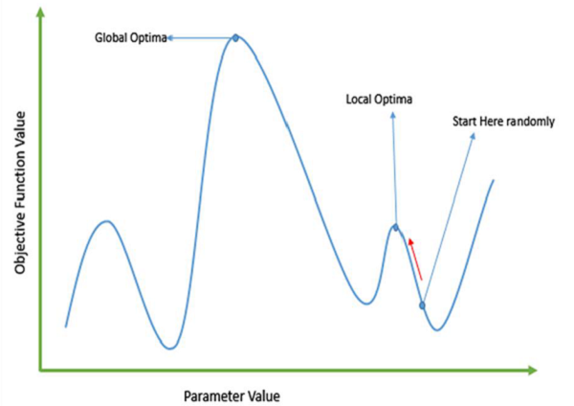
Failure of gradient-based methods
Traditional calculus based methods work by starting at a random point and by moving in the direction of the gradient, till we reach the top of the hill.
This technique is efficient and works very well for single-peaked objective functions
But, in many real-world situations, which are made of many peaks and many valleys, such methods fail, as they suffer from an inherent tendency of getting stuck at the local optima

Slide 26
Limitations of GAs
GAs are not suited for all problems, especially problems which are simple and for which derivative information is available.
Fitness value is calculated repeatedly which might be computationally expensive for some problems.
Being stochastic, there are no guarantees on the optimality or the quality of the solution.
If not implemented properly, the GA may not converge to the optimal solution.

Slide 27
Solving difficult problems with GAs
In computer science, there is a large set of problems, which are NP-Hard.
Travelling Salesperson Problem (TSP)
Some difficult problems like the Travelling Salesperson Problem (TSP), have real-world applications like path finding and VLSI Design.
What this essentially means is that, even the most powerful computing systems take a very long time (even years!) to solve that problem.
Imagine that you are using your GPS Navigation system, and it takes a few minutes (or even a few hours) to compute the “optimal” path from the source to destination.
Delay in such real world applications is not acceptable and therefore a “good-enough” solution, which is delivered “fast” is what is required.
In such a scenario, GAs prove to be an efficient tool to provide usable near-optimal solutions in a short amount of time.
Albeit, with no global optima guarantees

Slide 28
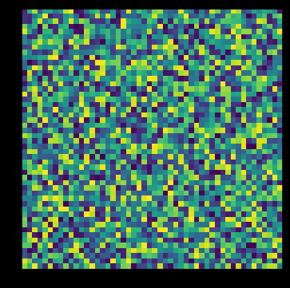
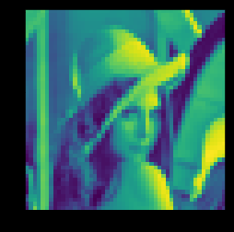
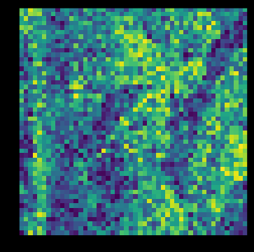
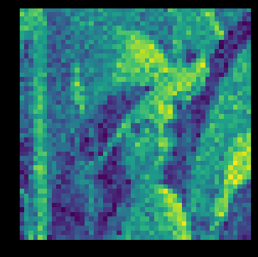
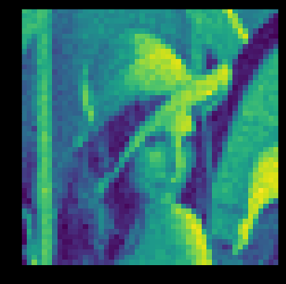
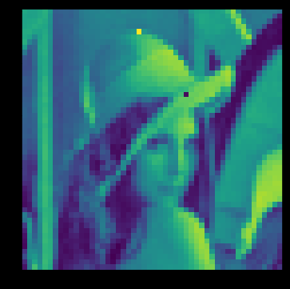
A word on genetic algorithm exercise
Iterations

